Slide 1


Sales & Financial Insights for Atliq Hardware
Presented By: Mohamed Asif

Slide 2

Overview
Introduction
01
PROBLEM STATEMENT
02
PROJECT OVERVIEW
03
EXECUTIVE SUMMARY
06
DATA MODEL
18

Slide 3

Introduction
A brief overview of AtliQ Hardware and the report’s focus on analyzing sales and financial performance.
AtliQ Hardware is a top distributor and retailer of IT hardware and consumer electronics. The company provides high-quality products like computer components and networking equipment to individuals and businesses. Known for its innovation and customer focus, AtliQ has earned a strong reputation across various markets.

Slide 4

Problem Statement
Identifying challenges in AtliQ Hardware's sales and financial performance for actionable insights.
AtliQ Hardware is experiencing declining sales in the competitive Latin American market, leading to significant financial losses. Competitors like Dell and HP are capturing market share, intensifying the challenge.
This situation calls for an in-depth analysis to identify gaps and develop strategies to regain a competitive edge.

Slide 5

Project Overview
A summary of the report’s purpose and the valuable insights it provides.
This project analyzes AtliQ Hardware’s sales and financial performance, focusing on historical data, market trends, and profit and loss insights.
It identifies patterns in revenue, expenses, and profitability, enabling data-driven strategies for growth and Optimization.

Slide 6
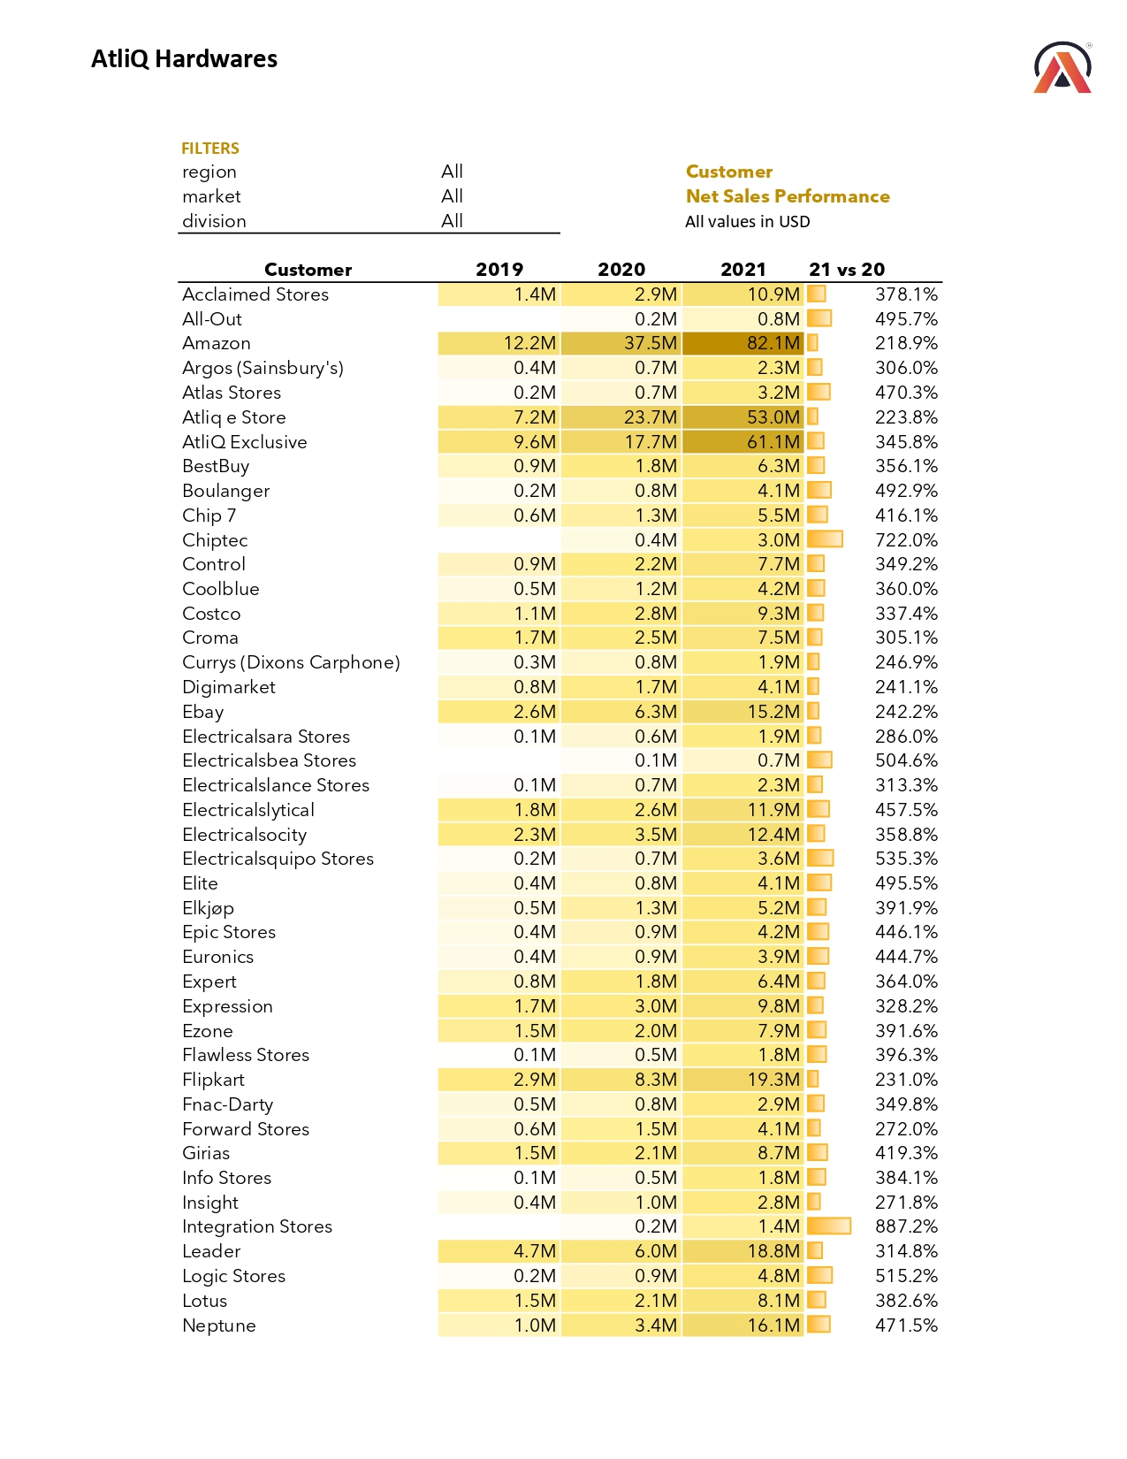
Executive
Summary
Customer Performance Report

Slide 7
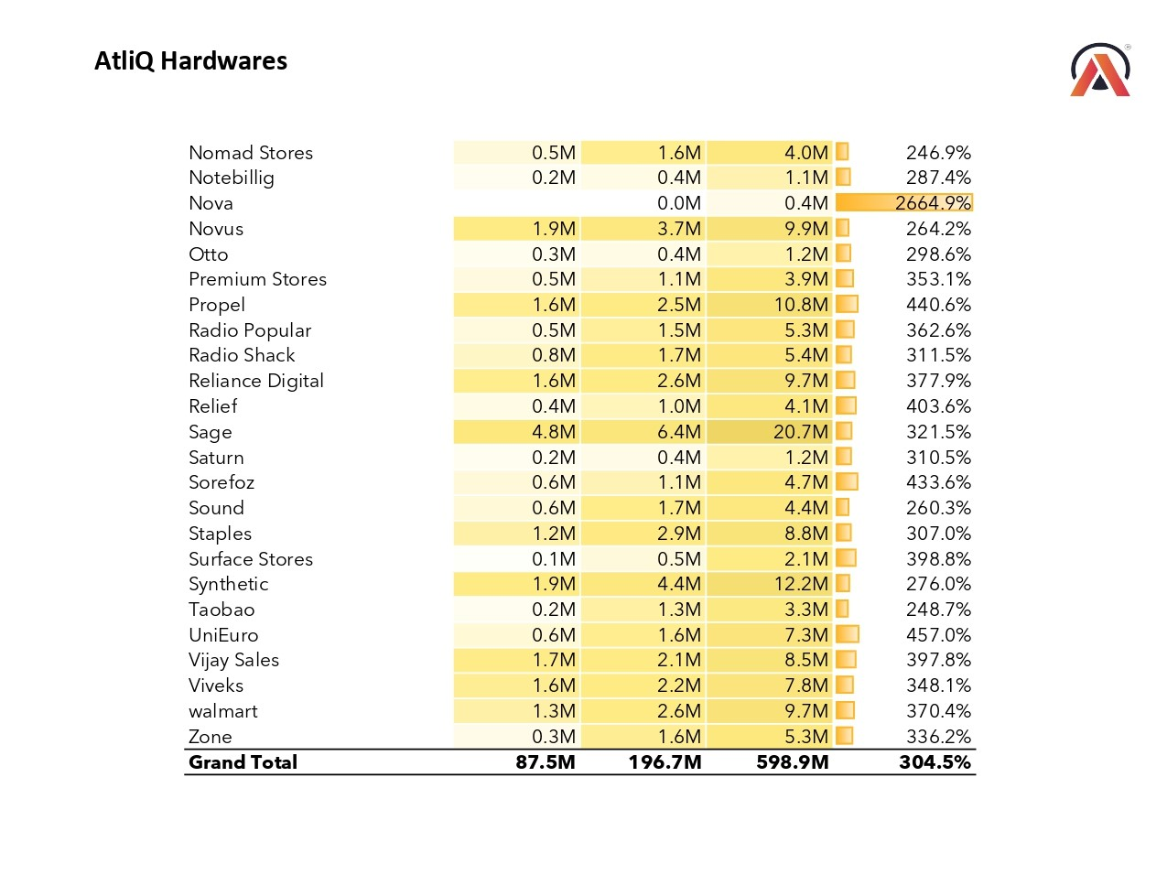
Executive Summary
Customer Performance Report

Slide 8
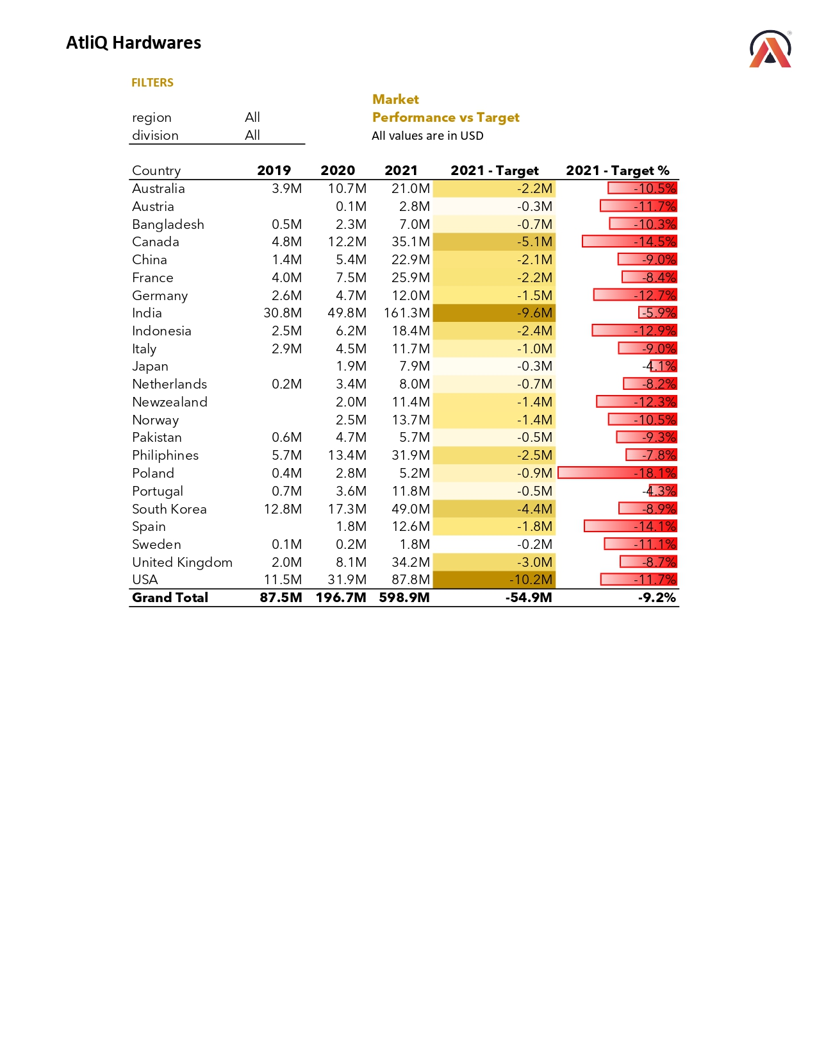
Executive Summary
Market Performance vs Target Report

Slide 9
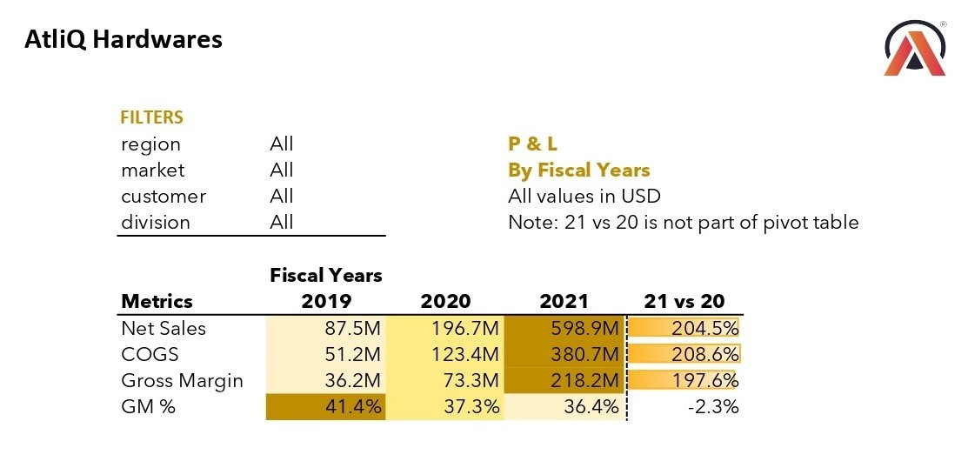
Executive Summary
Profit & Loss (P&L) Statement by Fiscal Years Report

Slide 10
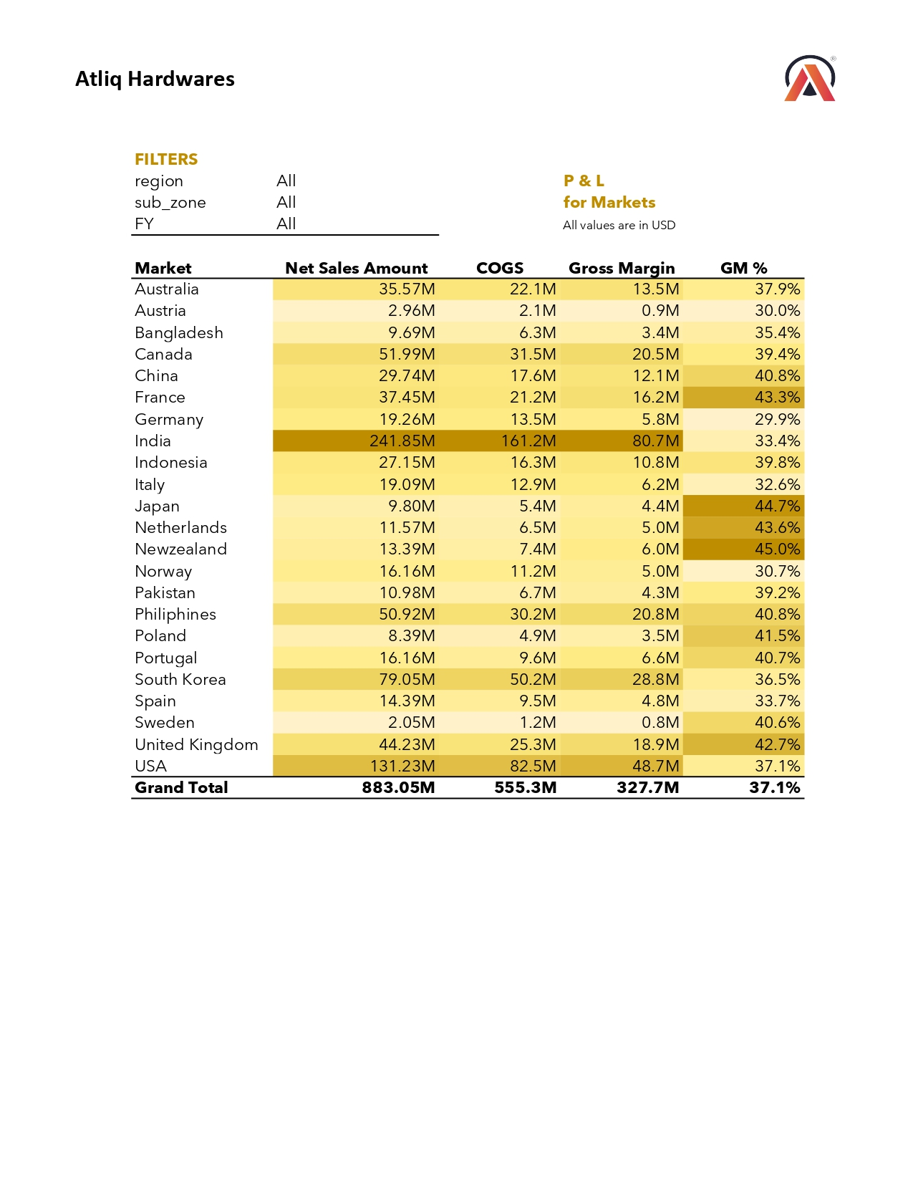
Executive Summary
Profit & Loss (P&L) Statement by Markets Report

Slide 11
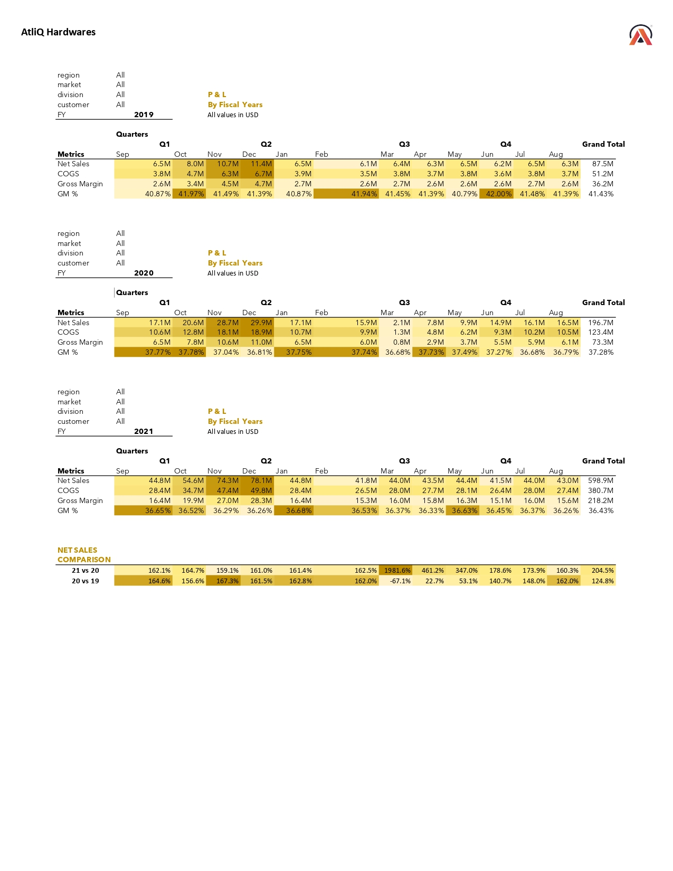
Executive Summary
Profit & Loss (P&L) Statement by Month Report

Slide 12
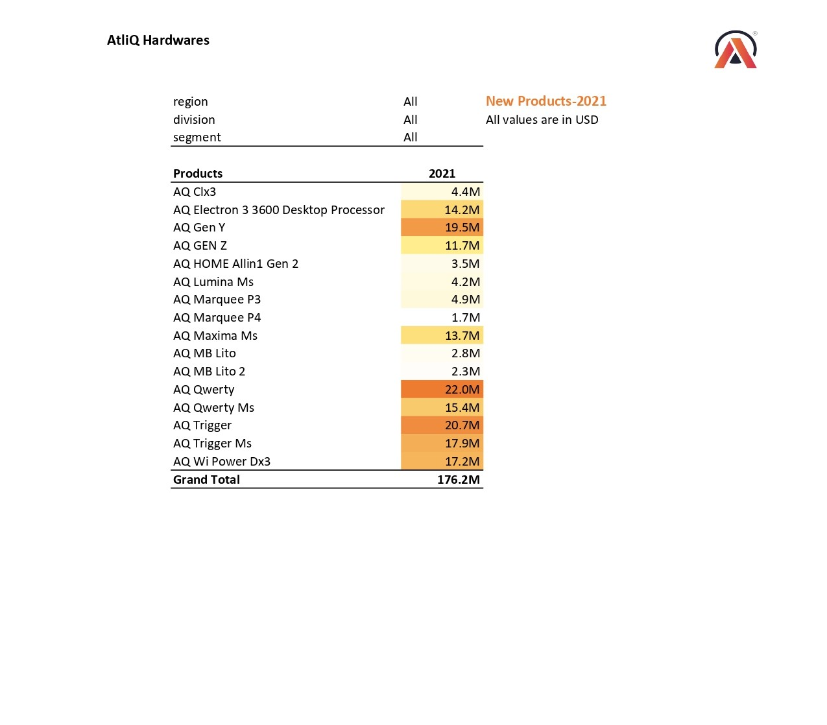
Executive Summary
New Products by Fiscal Year Report - 2021

Slide 13
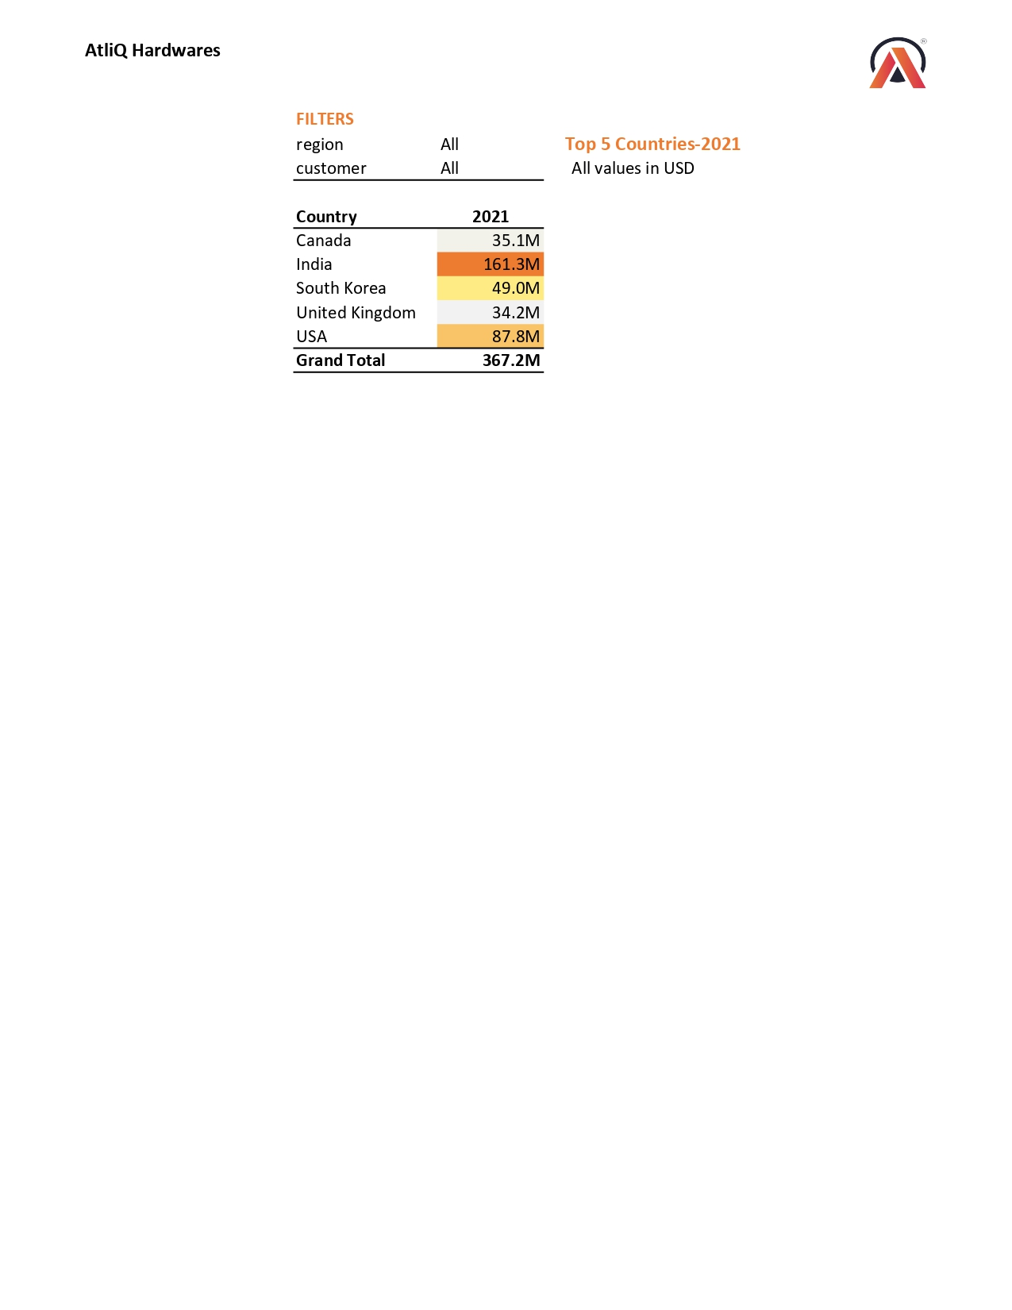
Executive Summary
Top 5 Country / Markets Report

Slide 14
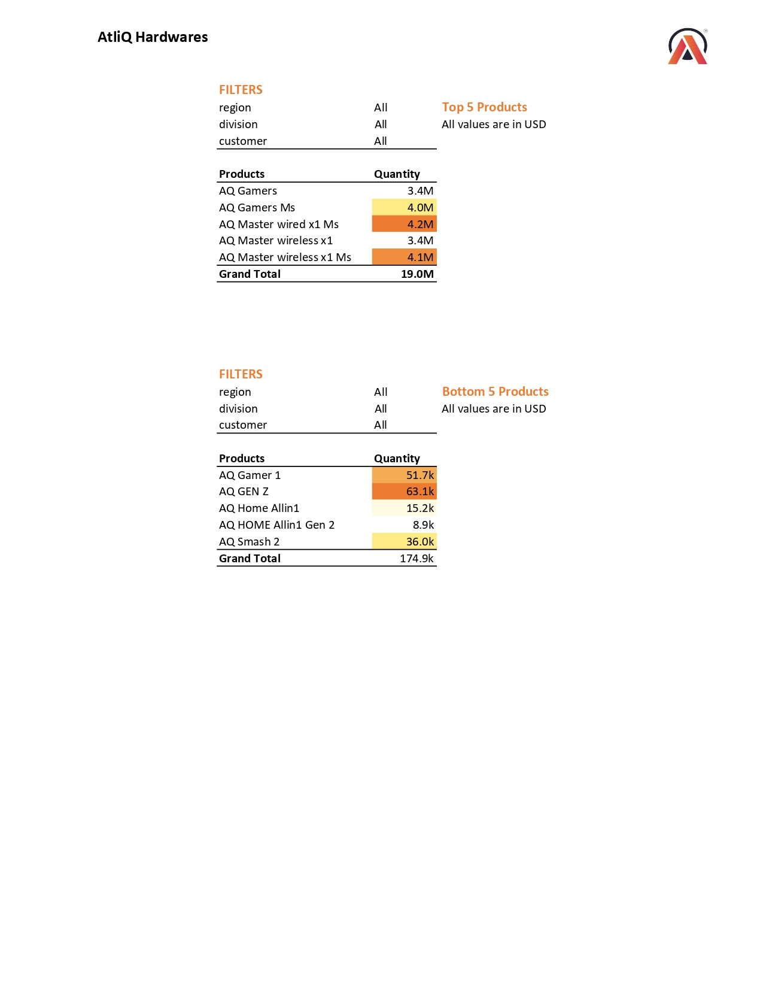
Executive Summary
Top 5 & Bottom 5 Products Report

Slide 15
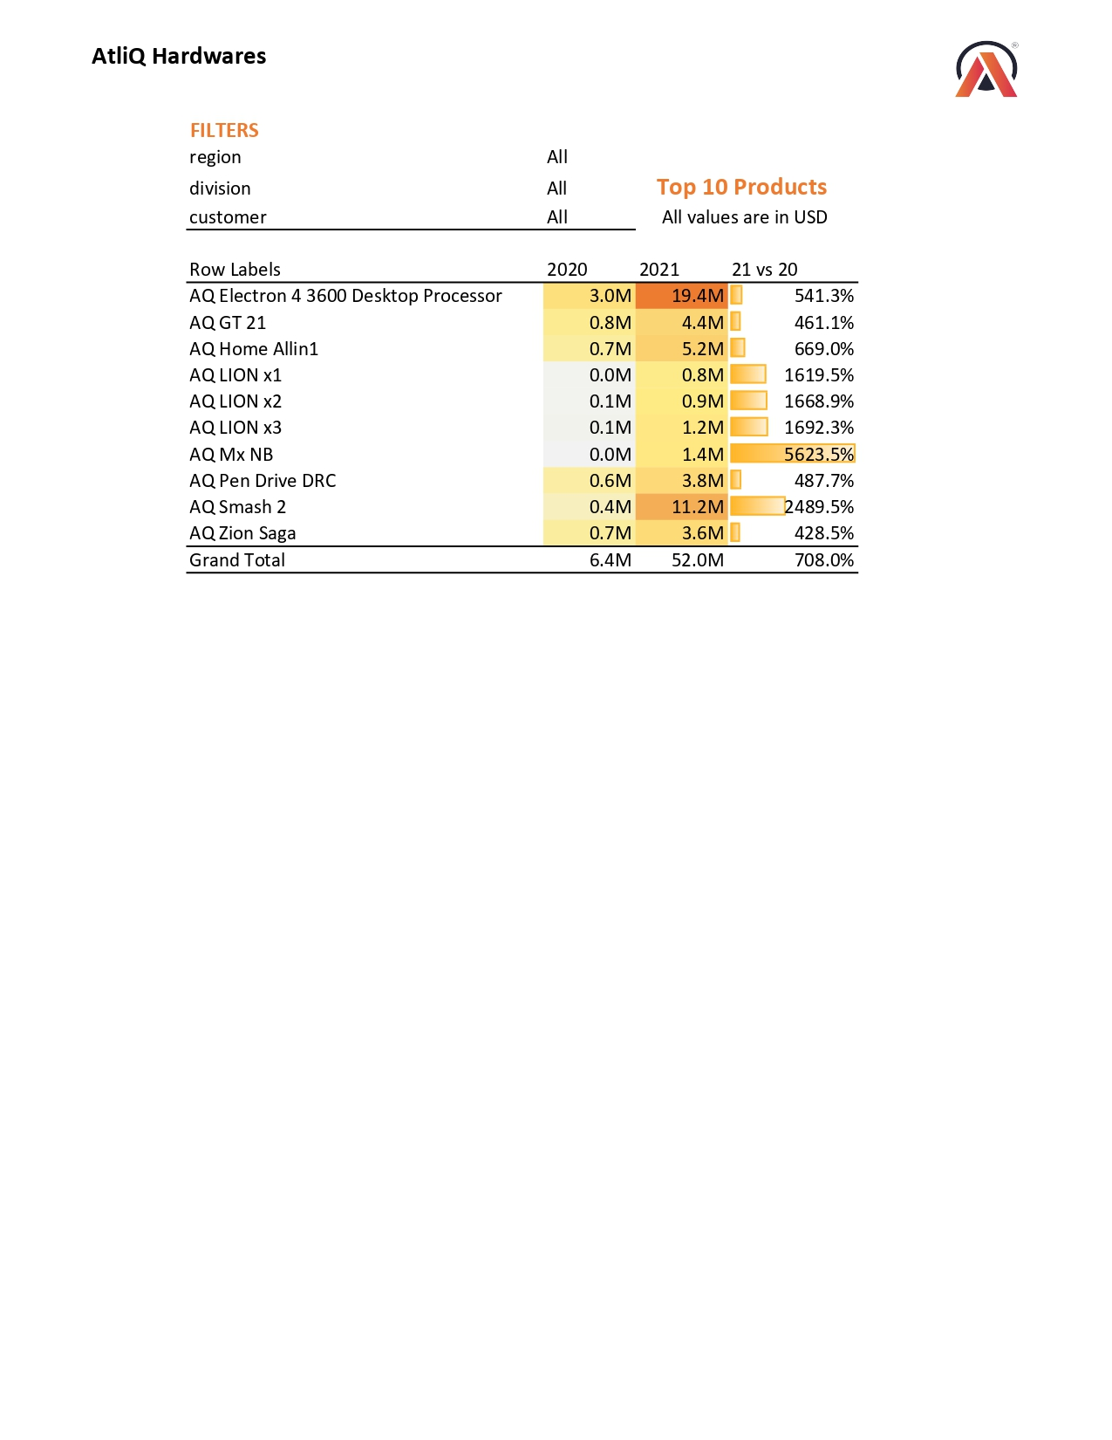
Executive Summary
Top 10 Products Report

Slide 16
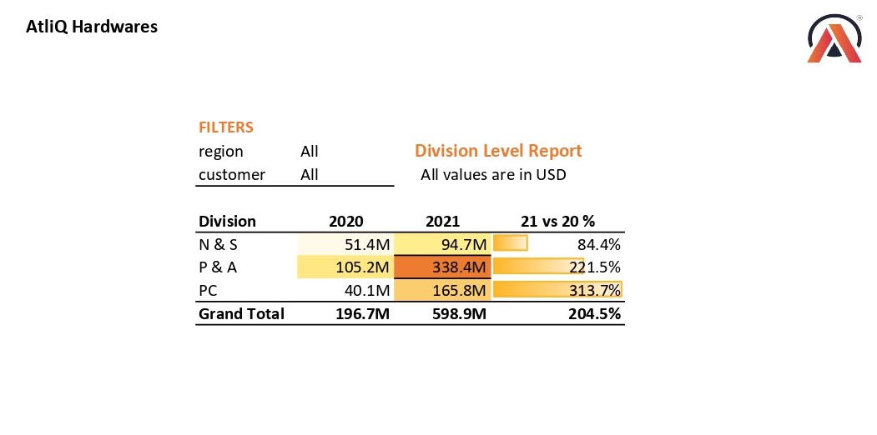
Executive Summary
Division Level Report

Slide 17
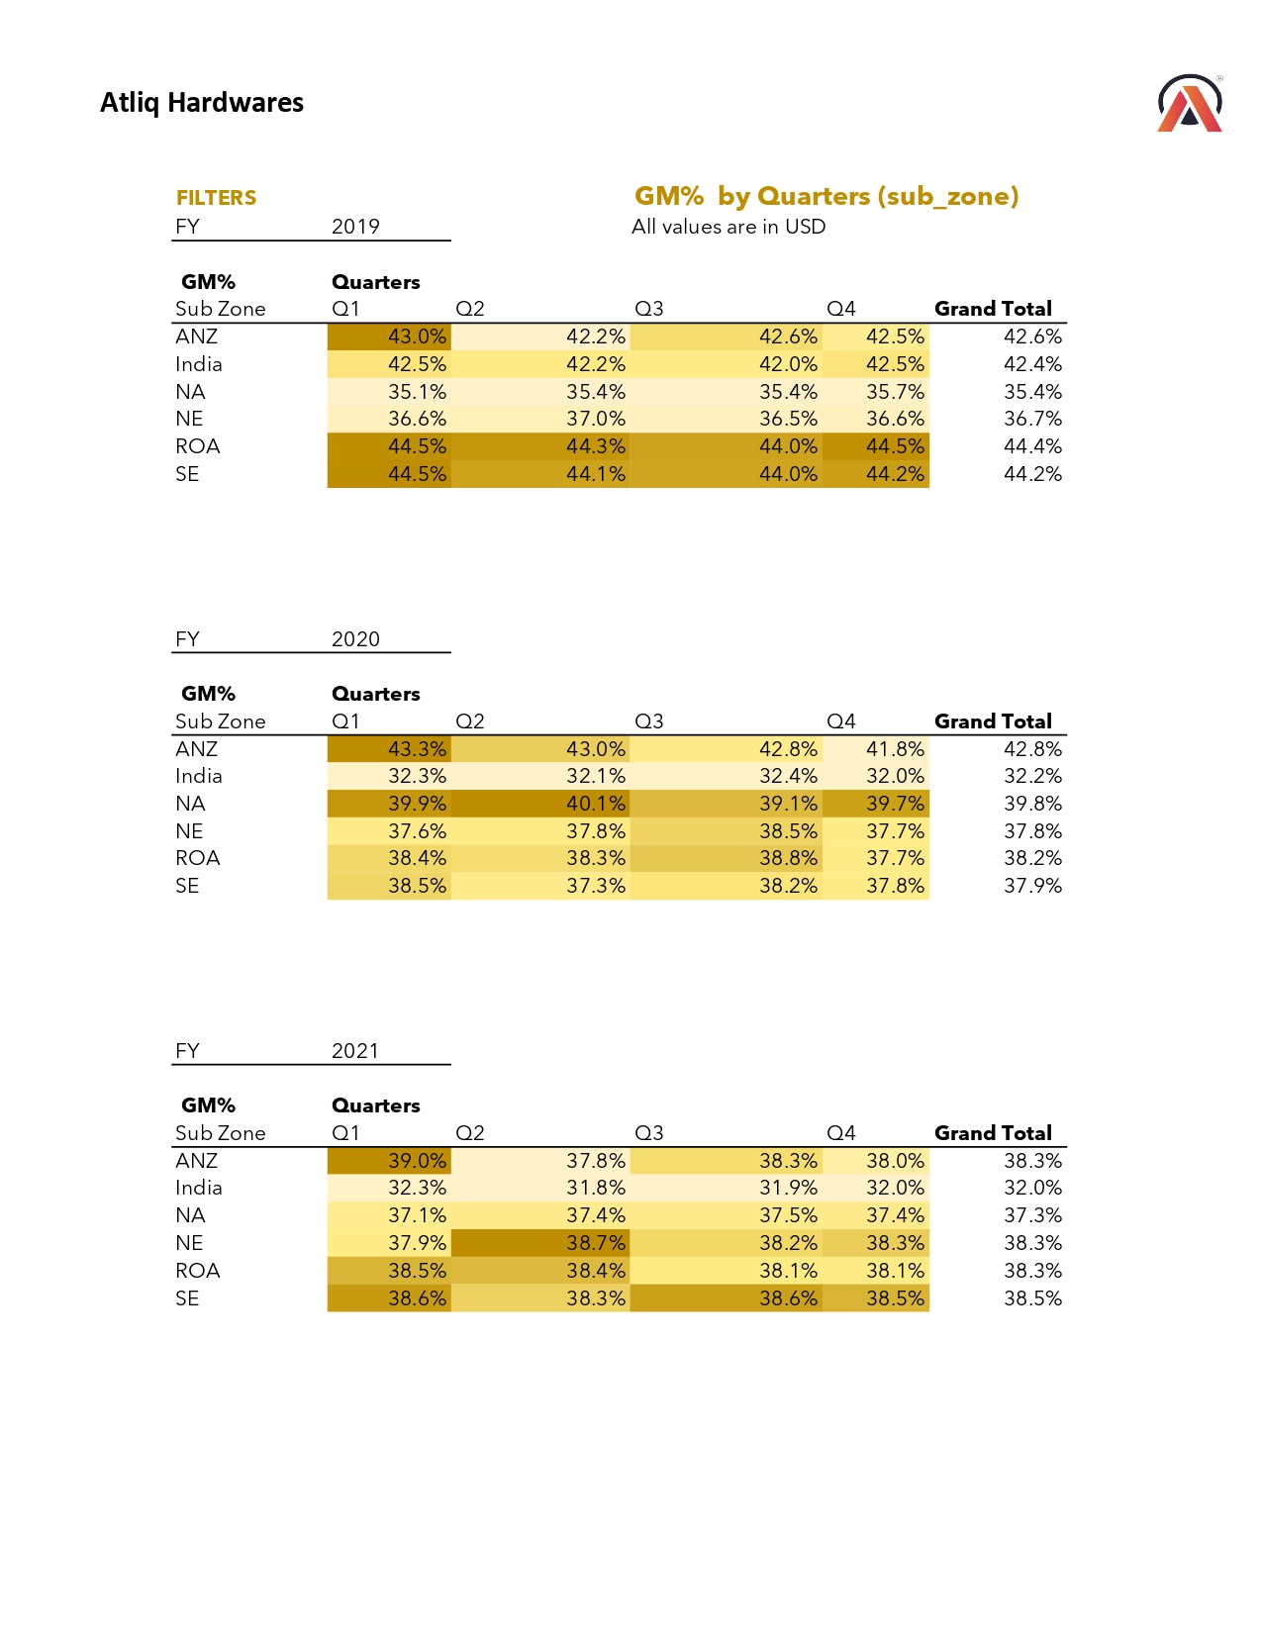
Executive Summary
Gross Margin (GM) % by Quarters

Slide 18
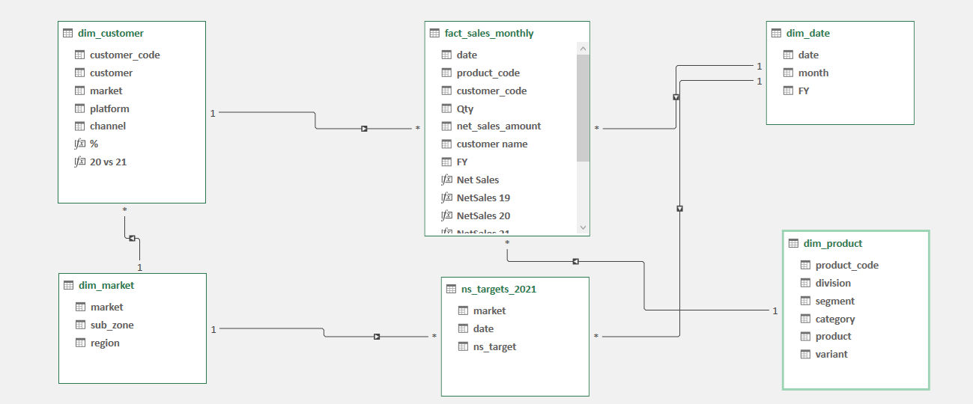

DATA MODEL

Slide 19



THANK YOU!
Mohamed Asif
+91 87547 99824
www.linkedin.com/in/mohamed-asif-03a0a4247

